Slide 1
Event-based Microservices
Josh Lane
@jplane

Slide 2
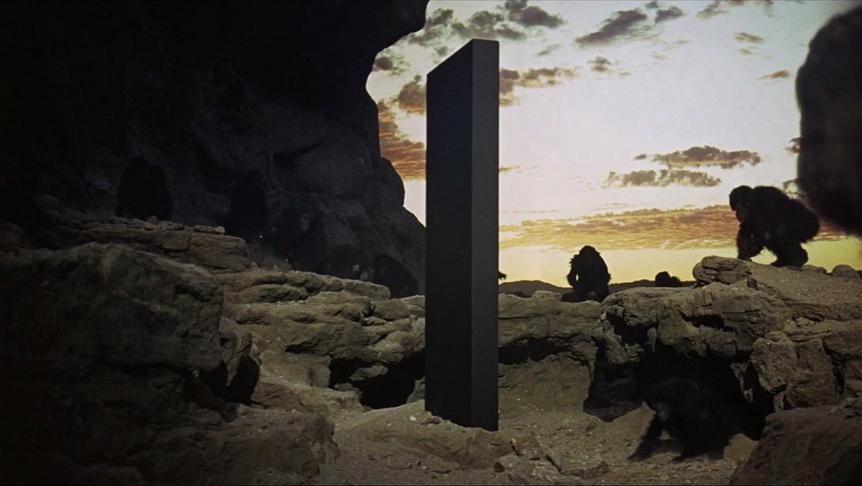
ACT I The Monolith

Slide 3


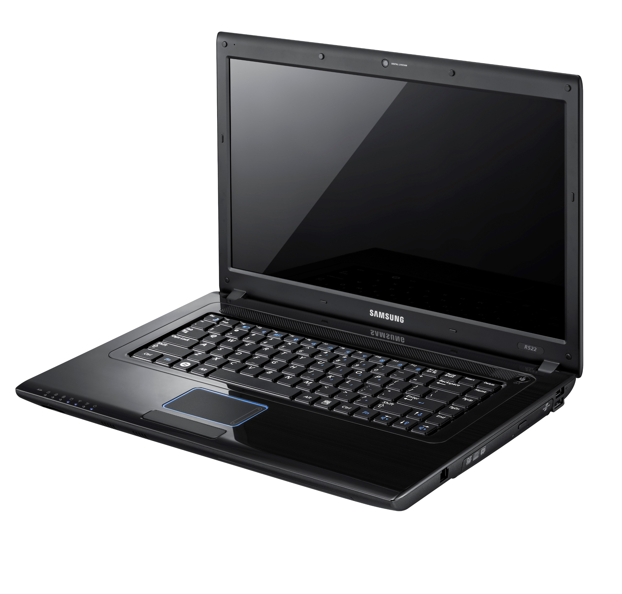
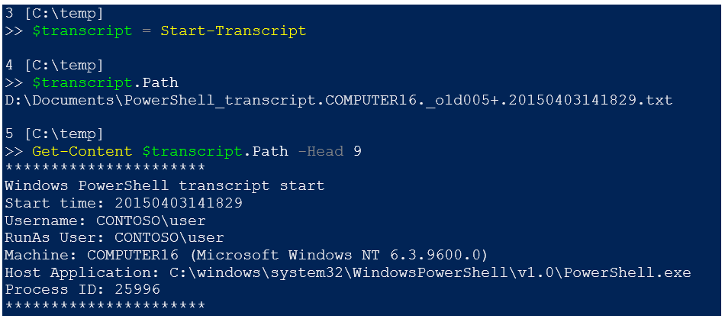
Web API
Inventory
Booking
Maintenance

Slide 4
Monolith

Slide 5
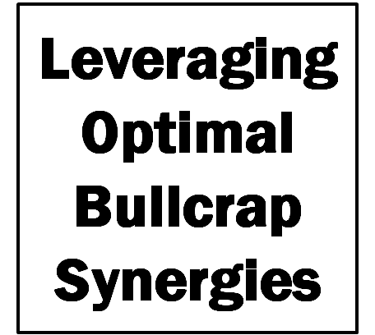
ACT II Minimum Viable Buzzword Compliance

Slide 6

External Inventory
API Facade
Internal Inventory
Booking
Maintenance

Slide 7
Microservices

Slide 8
External Inventory
API Facade
Internal Inventory
Booking
Maintenance

Slide 9

Let’s Be Independent, Together

Slide 10
Event Bus
External Inventory
API Facade
Internal Inventory
Booking
Maintenance

Slide 11
Microservices + Events

